Slide 1
DATA MINING

Slide 2
INTRODUCTION
In general terms, “Mining” is the process of extraction of some valuable material from the earth e.g. coal mining, diamond mining etc.
In the context of computer science, “Data Mining”refers to the extraction of useful information from a bulk of data or data warehouse.
Data mining is used in almost all the places where a large amount of data is stored and processed.
the information gathered from Data Mining helps to predict hidden patterns, future trends and behaviors and allowing businesses to take decisions.

Slide 3
Data Mining as a whole process
The whole process of Data Mining comprises of three main phases:
1. Data Pre-processing – Data cleaning, integration, selection and transformation takes place.
2. Data Extraction – Occurrence of exact data mining.
3. Data Evaluation and Presentation – Analyzing and presenting results.

Slide 4
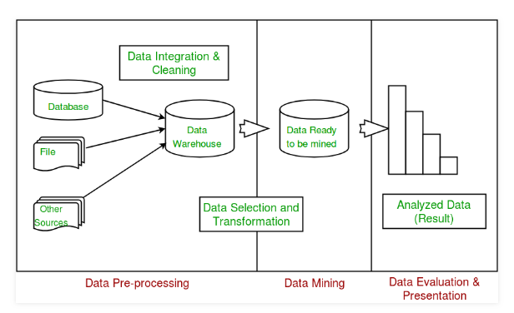

Slide 5
1. Data Pre-processing
Data pre-processing is not just about removing bad data or interpolating missing values, but about finding hidden correlations in the data, identifying sources of data that are the most accurate, and determining which columns are the most appropriate for use in analysis.
For data mining typically you are working with a very large dataset and cannot examine every transaction for data quality; therefore, you might need to use some form of data profiling and automated data cleansing and filtering tools

Slide 6
2. Data Extraction
You must understand the data in order to make appropriate decisions when you create the mining models. Exploration techniques include calculating the minimum and maximum values, calculating mean and standard deviations, and looking at the distribution of the data.
You can use tools such as SQL Server Data Quality Services, or the Data Profiler in Integration Services, to analyze the distribution of your data and repair issues such as wrong or missing data.

Slide 7
Data Mining Techniques
1.Classification:
2. Clustering:
3. Regression:
4. Association Rules:
5. Sequential Patterns:
6. Prediction:

Slide 8
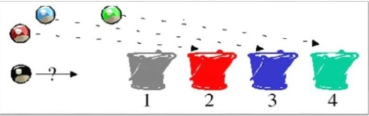
CLASSIFICATION
Classification is the process of predicting and assigning the class of a new item.
Therefore it used to classify the new item and identify the class in which it belongs.

Slide 9
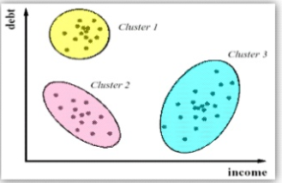
CLUSTERING
Cluster technique is used to group the mined data into Clusters
Similar Data is grouped together.
Dissimilar Data is grouped together.

Slide 10
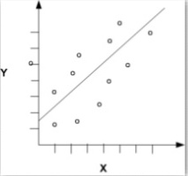
REGRESSION
Regression deals with the prediction of a value, rather than a class.
For example, a regression model could be used to predict height ,given their age, weight etc.

Slide 11
ASSOCIATION RULES
An Association rules algorithm creates rules that describe how often event have occurred together.

Slide 12

SEQUENTIAL PATTERN
This data mining technique helps to discover or identify similar patterns or trends in transaction data for certain period.

Slide 13
PREDICTION
Prediction has used a combination of the other data mining techniques like trends, sequential patterns, clustering, classification, etc. It analyzes past events or instances in a right sequence for predicting a future event.

Slide 14
Challenges of Implementation of Data mining.
Skilled Experts are needed to formulate the data mining queries.
Over fitting: Due to small size training database, a model may not fit future states.
Data mining needs large databases which sometimes are difficult to manage
Business practices may need to be modified to determine to use the information uncovered.
If the data set is not diverse, data mining results may not be accurate.
Integration information needed from heterogeneous databases and global information systems could be complex

Slide 15
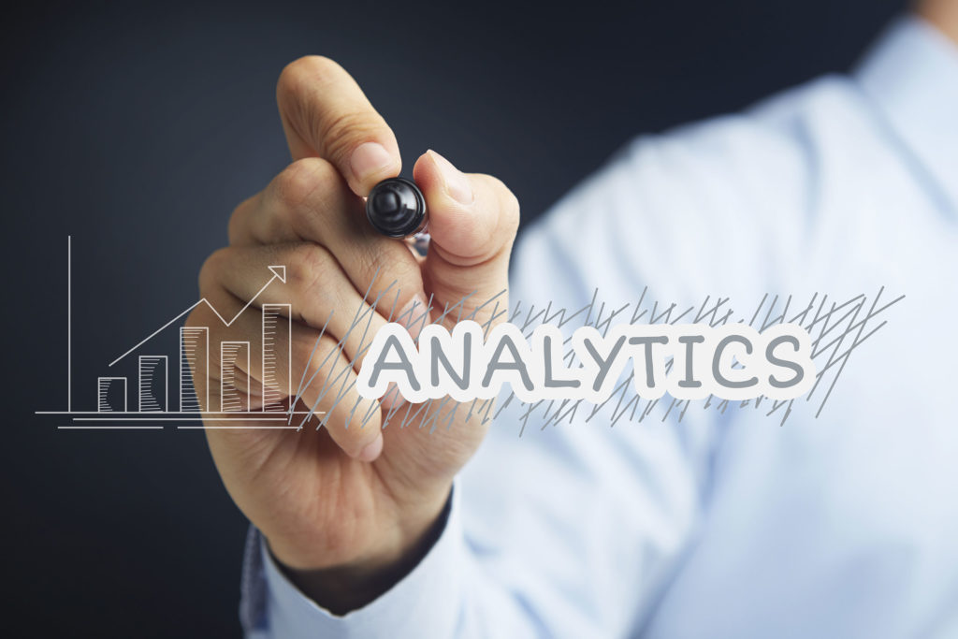
ADVANTAGES OF DATA MINING
Data mining technique helps companies to get knowledge-based information.
Data mining helps organizations to make the profitable adjustments in operation and production.
The data mining is a cost-effective and efficient solution compared to other statistical data applications.

Slide 16
Data mining helps with the decision-making process.
Facilitates automated prediction of trends and behaviors as well as automated discovery of hidden patterns.
It can be implemented in new systems as well as existing platforms
It is the speedy process which makes it easy for the users to analyze huge amount of data in less time.

Slide 17
DISADVANTAGES OF DATA MINING
There are chances of companies may sell useful information of their customers to other companies for money. For example, American Express has sold credit card purchases of their customers to the other companies. Google and Facebook were also accused of data misplacement and were called to testify against the Congress.
Many data mining analytics software is difficult to operate and requires advance training to work on.
Different data mining tools work in different manners due to different algorithms employed in their design. Therefore, the selection of correct data mining tool is a very difficult task.
The data mining techniques are not accurate, and so it can cause serious consequences in certain conditions.

Slide 18
REAL WORLD APPLICATIONS
As the importance of data analytics continues to grow, companies are finding more and more applications for Data Mining.
Here we take a look at some real life applications of these technologies and shed light on the benefits they can bring.

Slide 19

E - COMMERCE
Perhaps some of the most well -known examples of Data Mining and Analytics come from E-commerce sites. Many E-commerce companies use Data Mining and Business Intelligence to offer cross-sells and up-sells through their websites. One of the most famous of these is, of course, Amazon, who use sophisticated mining techniques to drive their, ‘People who viewed that product, also liked this’ functionality.

Slide 20

SUPERMARKETS
Supermarkets provide another good example of Data Mining in action. Famously, supermarket loyalty card programmes are usually driven mostly, if not solely, by the desire to gather comprehensive data about customers for use in data mining. One notable recent example of this was with the US retailer Target. As part of its Data Mining programme, the company developed rules to predict if their shoppers were likely to be pregnant. By looking at the contents of their customers’ shopping baskets, they could spot customers who they thought were likely to be expecting and begin targeting promotions for nappies (diapers), cotton wool and so on. The prediction was so accurate that Target made the news by sending promotional coupons to families who did not yet realize (or who had not yet announced) they were pregnant!

Slide 21

CRIME AGENCY
The use of Data Mining and Business Intelligence is not solely reserved for corporate applications and this is shown in our final example. Beyond corporate applications, crime prevention agencies use analytics and Data Mining to spot trends across myriads of data – helping with everything from where to deploy police manpower (where is crime most likely to happen and when?), who to search at a border crossing (based on age/type of vehicle, number/age of occupants, border crossing history) and even which intelligence to take seriously in counter-terrorism activities.

Slide 22
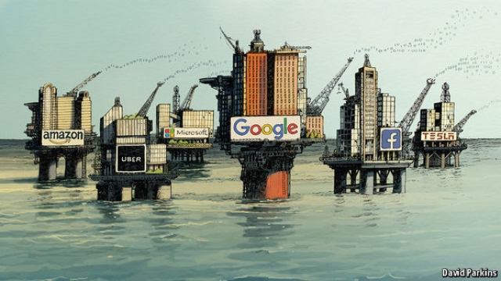
DATA BIGGER THAN OIL?
Oil has reigned for centuries as one of society’s most valuable resources. Throughout history, those who have controlled oil, have controlled the economy. However, in today’s “data economy,” it can be argued that data, due to the insight and knowledge that can be extracted from it, is potentially more valuable. Like oil, raw data’s value comes from its potential to be refined into an essential commodity.

